Slide 1
An introduction to Docker
Huichao Zhao

Slide 2
Outline
What is Docker and why is it so hot
Strata of the Container Ecosystem
Difference Between LXD and Docker
Minimalistic OS for container
Container Orchestration Wars

Slide 3
Outline
What is Docker and why is it so hot
Strata of the Container Ecosystem
Difference Between LXD and Docker
Minimalistic OS for container
Container Orchestration Wars

Slide 4
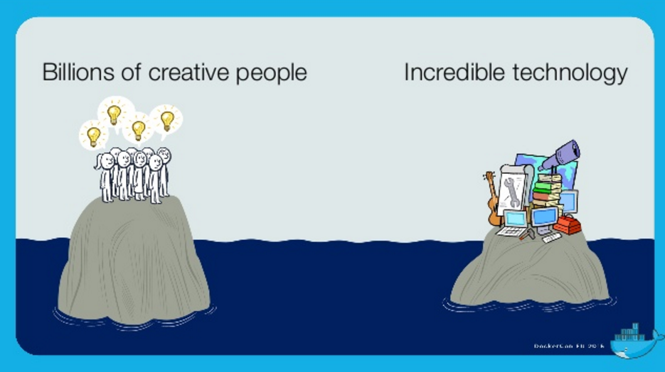
What is Docker and why is it so hot ？
http://www.slideshare.net/JochenZehnder/what-is-docker-and-why-is-it-so-hot

Slide 5
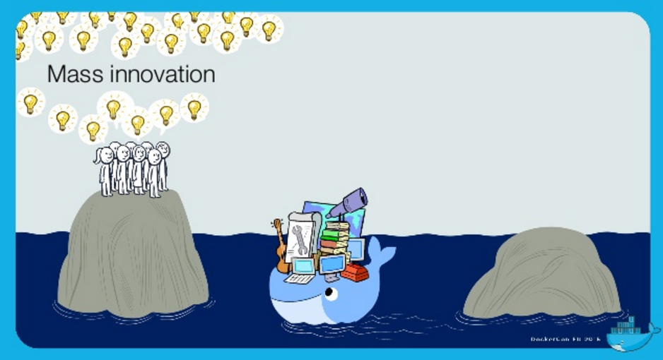
What is Docker and why is it so hot ？
http://www.slideshare.net/JochenZehnder/what-is-docker-and-why-is-it-so-hot

Slide 6
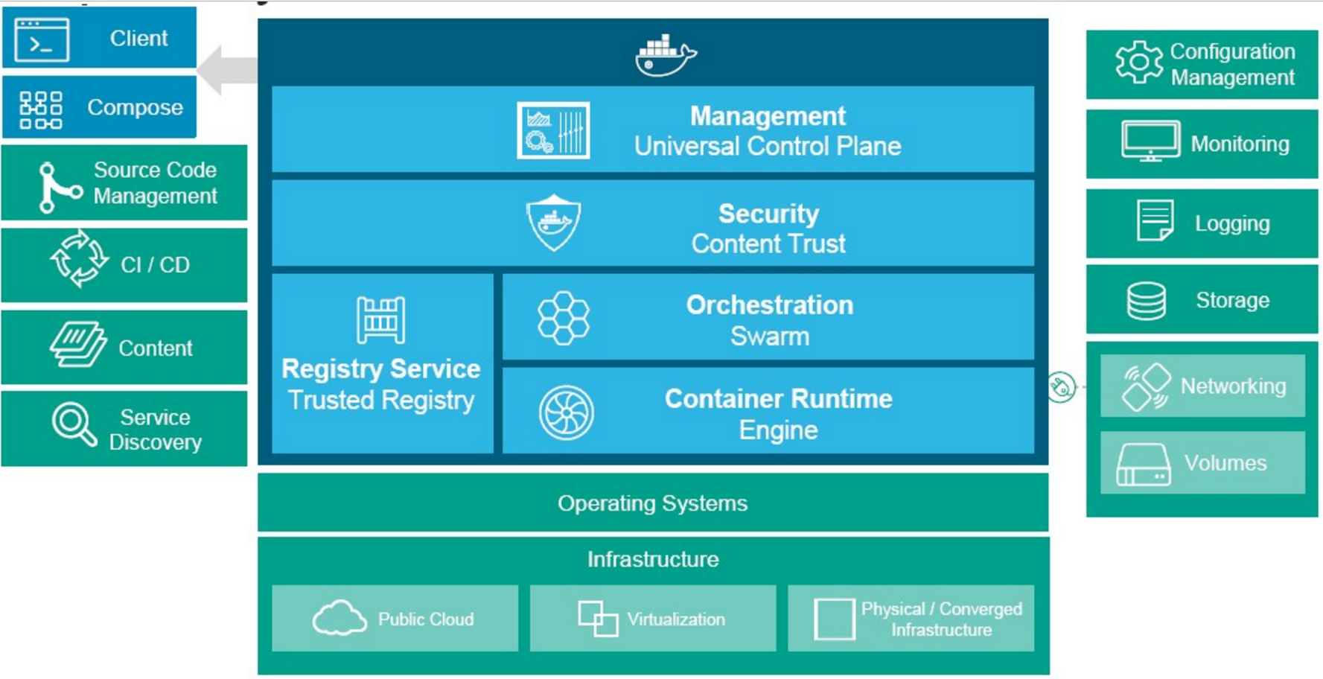
What is Docker and why is it so hot ？
http://www.nextplatform.com/2016/02/23/docker-trickles-down-from-hyperscale-to-enterprise/

Slide 7
What is Docker and why is it so hot ？
https://www.docker.com/survey-2016

Slide 8
Outline
What is Docker and why is it so hot
Strata of the Container Ecosystem
Difference Between LXD and Docker
Minimalistic OS for container
Container Orchestration Wars

Slide 9
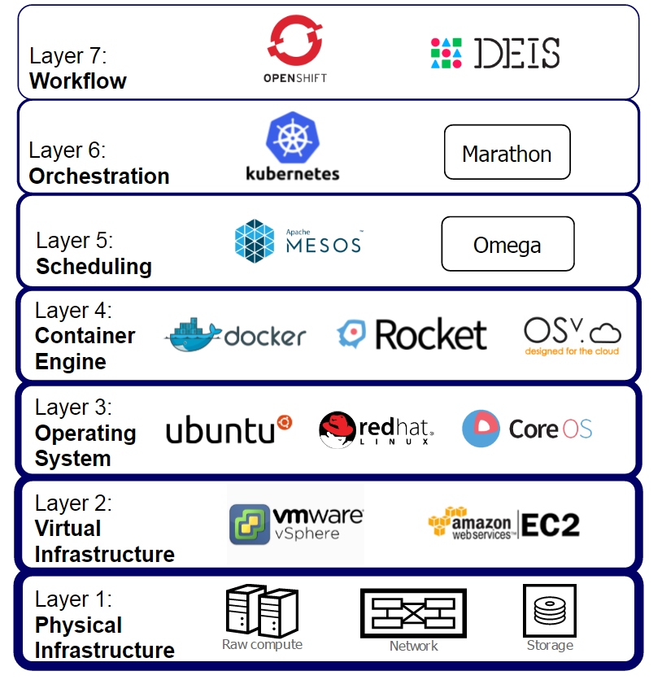
Strata of the Container Ecosystem
Container Ecosystem Layers
October 18, 2015
https://getcarina.com/docs/best-practices/container-technologies-orchestration-clusters/

Slide 10
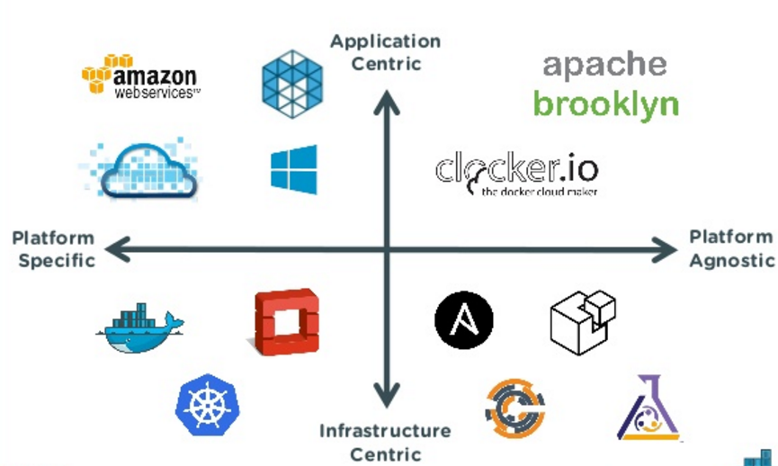
Strata of the Container Ecosystem
Another View of Container Ecosystem
Docker. Inc. Nov 23, 2015
http://www.slideshare.net/Docker/multicontainer-apps-spanning-docker-mesos-and-openstack

Slide 11
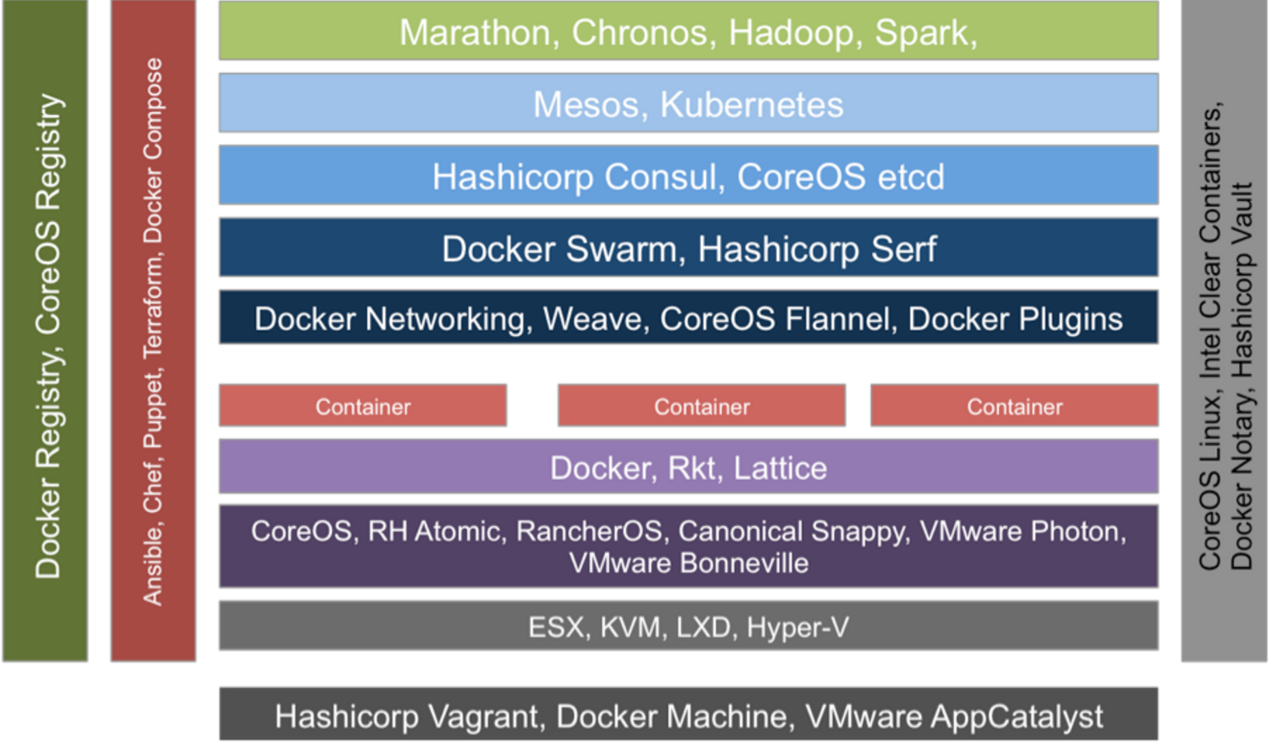
Strata of the Container Ecosystem
Another View of Technology Choices
http://wikibon.com/wp-content/uploads/container_implementations.png

Slide 12
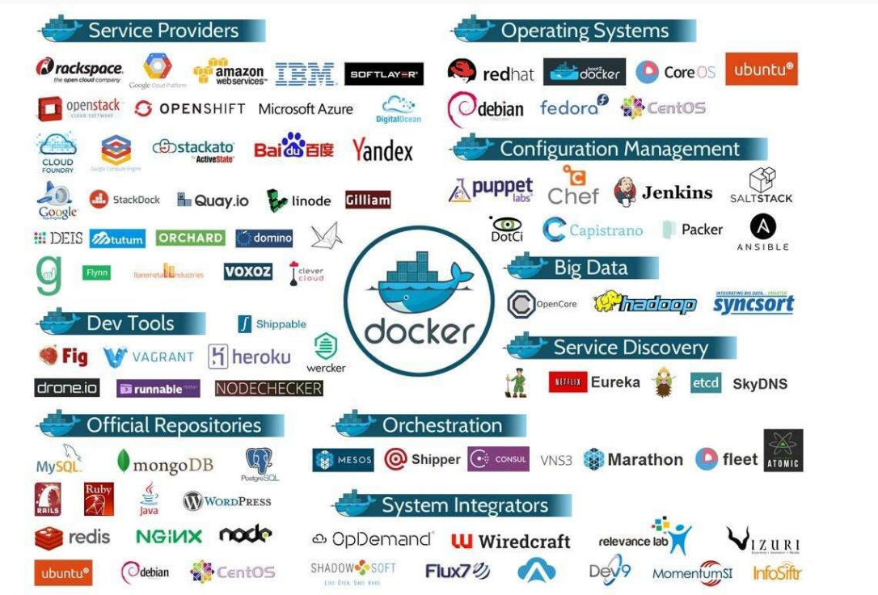
Strata of the Container Ecosystem
Another View of Docker Ecosystem
https://linuxforafrica.org/Docs/2015/01/docker/

Slide 13
Outline
What is Docker and why is it so hot
Strata of the Container Ecosystem
Difference Between LXD and Docker
Minimalistic OS for container
Container Orchestration Wars

Slide 14
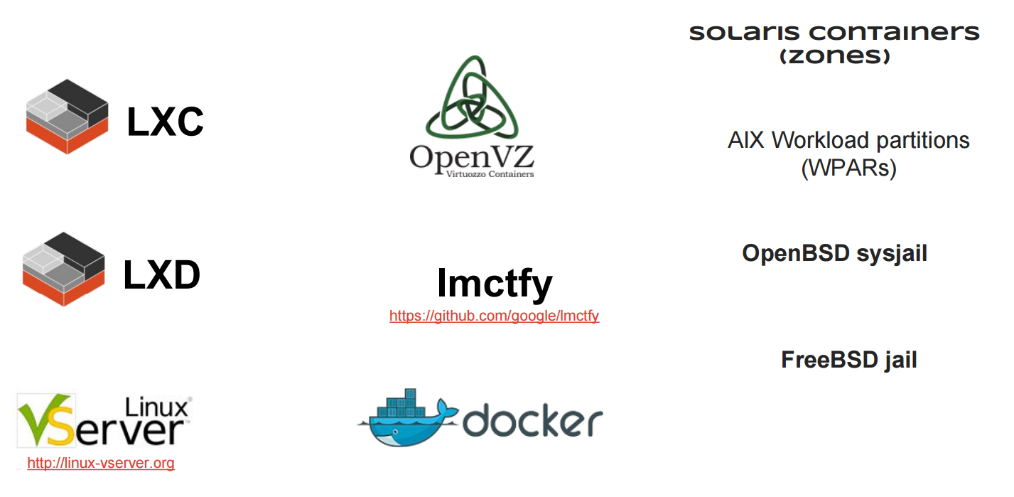
Difference Between LXD and Docker
OS-Level Virtualization
http://www.slideshare.net/ejlp12/linux-containarization-docker

Slide 15
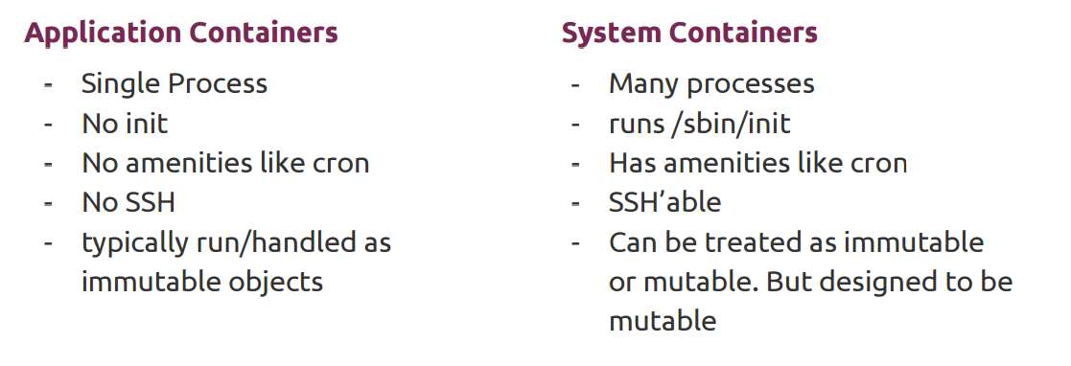
Difference Between LXD and Docker
OS-Level Virtualization
Example: LXC/LXD, OpenVZ, Oracle Solaris Zones, FreeBSD Jails
Example: Docker, rkt
https://archive.fosdem.org/2016/schedule/event/config_management_containers/attachments/slides/1110/export/events/attachments/config_management_containers/slides/1110/lazypower_fosdem2016_configmanagement_and_containers.pdf

Slide 16
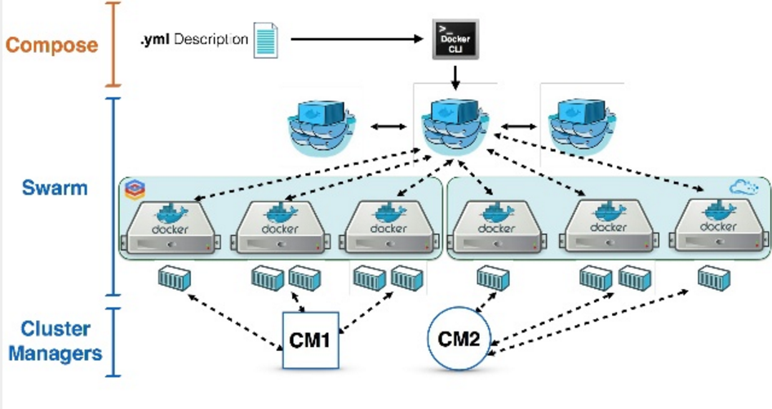
Difference Between LXD and Docker
http://www.slideshare.net/dustinkirkland/streamlining-hpc-workloads-with-containers?qid=bad52f10-d5e7-4741-bc13-b80935c288af&v=&b=&from_search=2

Slide 17
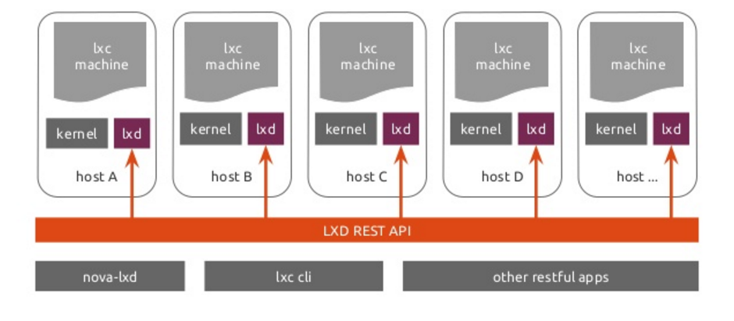
Difference Between LXD and Docker
One LXD container, with 100% of the system:
CPU Cores, CPU Cycles, Memory, Disk Space, Disk IO, Network IO
zero latency, zero overhead, identical performance, snapshot restore, live migration
http://www.slideshare.net/dustinkirkland/streamlining-hpc-workloads-with-containers?qid=bad52f10-d5e7-4741-bc13-b80935c288af&v=&b=&from_search=2

Slide 18
Difference Between LXD and Docker
Docker and LXD are complementary
LXD gives you a classic virtual machine experience with all your administrative processes running there, from sshd to syslog, so LXD feels just like a normal machine. All the apps work the same way, operations are identical, and of course you can run your Docker processes inside LXD containers.
By contrast, Docker strips the container down to the naked application process, giving you fantastic density but requiring you to use a dedicated container coordination system like Kubernetes.
https://www.ubuntu.com/cloud/lxd

Slide 19
Outline
What is Docker and why is it so hot
Strata of the Container Ecosystem
Difference Between LXD and Docker
Minimalistic OS for container
Container Orchestration Wars

Slide 20
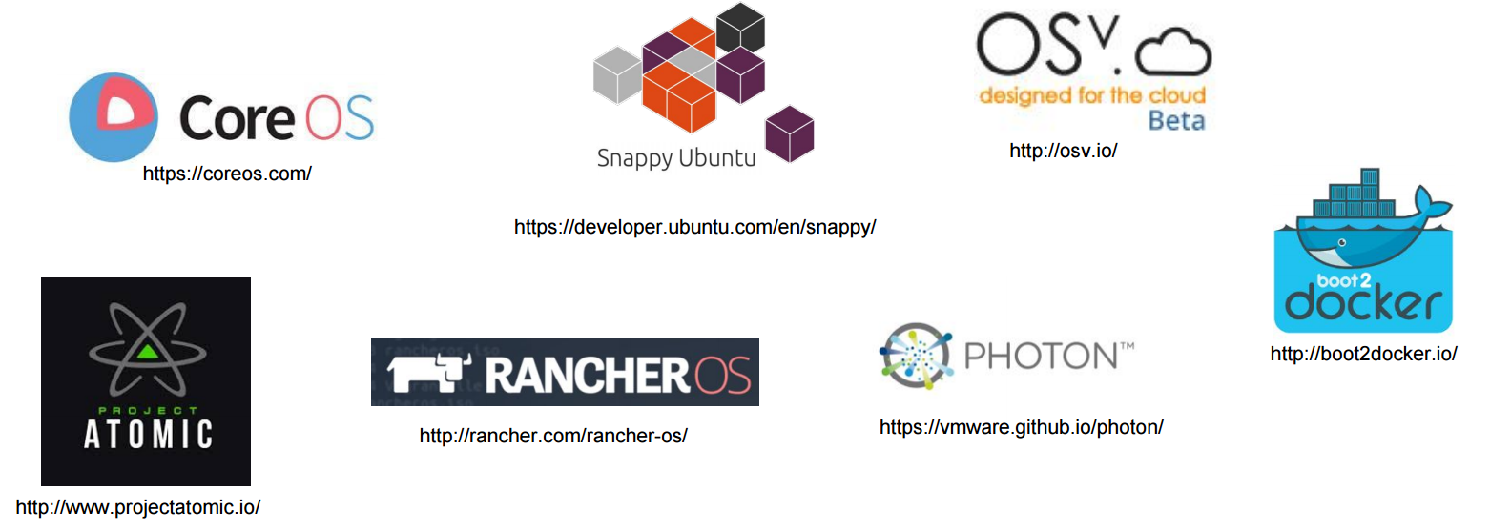
Minimalistic OS for container
A common set of ideas:
Stability is enhanced through transactional upgrade/rollback semantics.
Traditional package managers are absent and may be replaced by new packaging systems (Snappy), or custom image builds (Atomic).
Security is enhanced through various isolation mechanisms.
systemd provides system/service management. In general, systemd has been adopted almost universally among Linux distributions, so this shouldn’t be a surprise.
GEPOSTET AM 4. MAI 2015
https://www.inovex.de/blog/docker-a-comparison-of-minimalistic-operating-systems/ http://www.slideshare.net/ejlp12/linux-containarization-docker

Slide 21
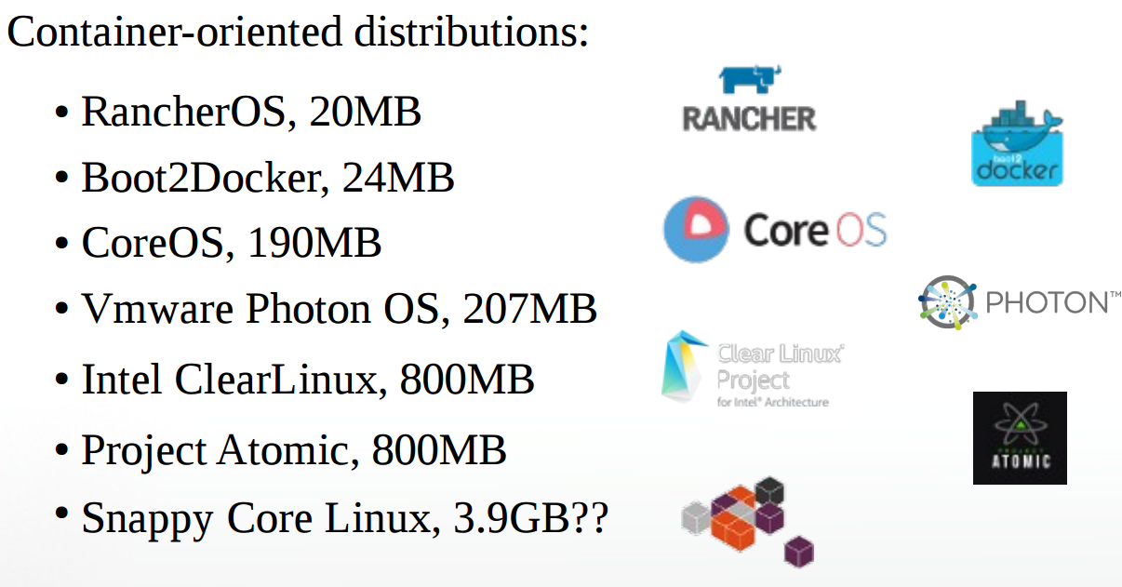
Minimalistic OS for container
Host OS Options
Dermot Bradley, Sep 2015
http://www.slideshare.net/DermotBradley/microcontainers-microservices-microservers-less-linux-is-more

Slide 22
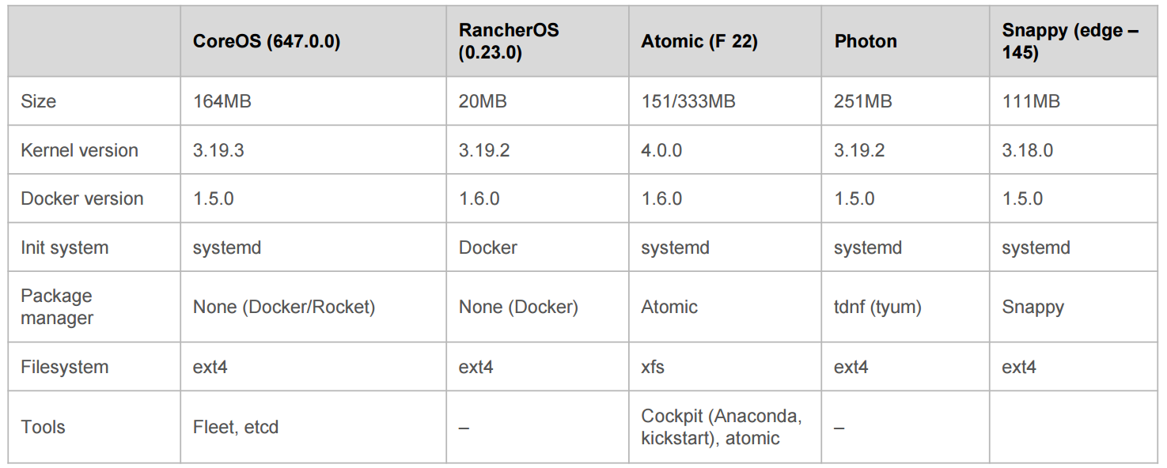
Minimalistic OS for container
Comparison table
GEPOSTET AM 4. MAI 2015
https://www.inovex.de/blog/docker-a-comparison-of-minimalistic-operating-systems/ http://datacenteroperatingsystem.io/

Slide 23
Outline
What is Docker and why is it so hot
Strata of the Container Ecosystem
Difference Between LXD and Docker
Minimalistic OS for container
Container Orchestration Wars

Slide 24
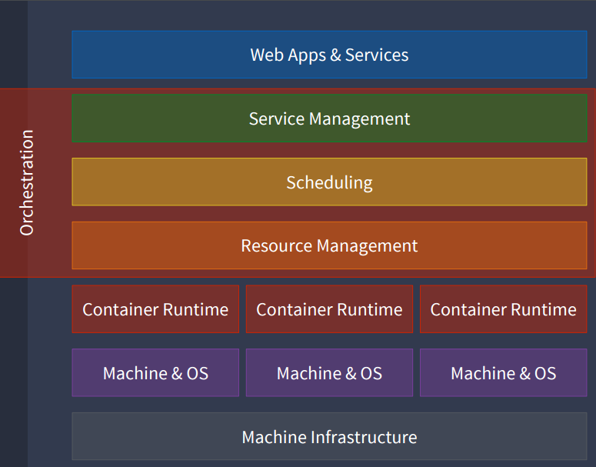
Container Orchestration Wars
CONTAINER ORCHESTRATION
http://www.slideshare.net/KarlIsenberg/container-orchestration-wars

Slide 25
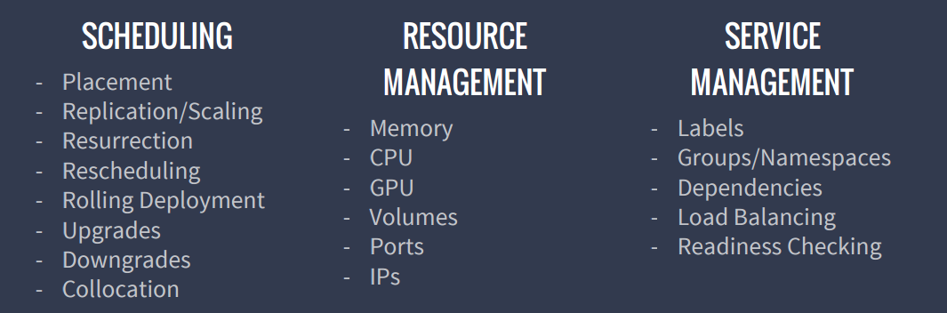
CONTAINER ORCHESTRATION
FUNCTIONAL CAPABILITIES
http://www.slideshare.net/KarlIsenberg/container-orchestration-wars

Slide 26
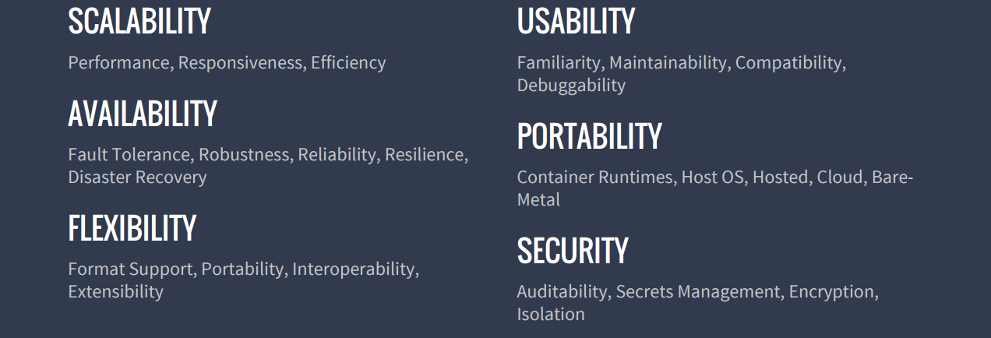
CONTAINER ORCHESTRATION
NON-FUNCTIONAL QUALITIES
http://www.slideshare.net/KarlIsenberg/container-orchestration-wars

Slide 27
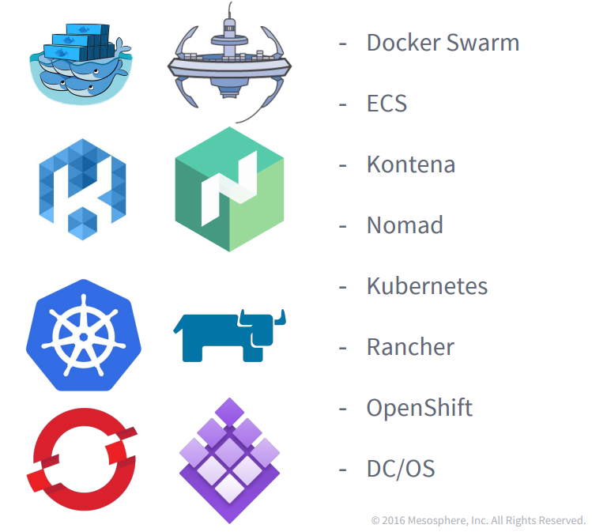
Container Orchestration Wars
Today’s Contestants(Non-Exhaustive List)
http://www.slideshare.net/KarlIsenberg/container-orchestration-wars

Slide 28
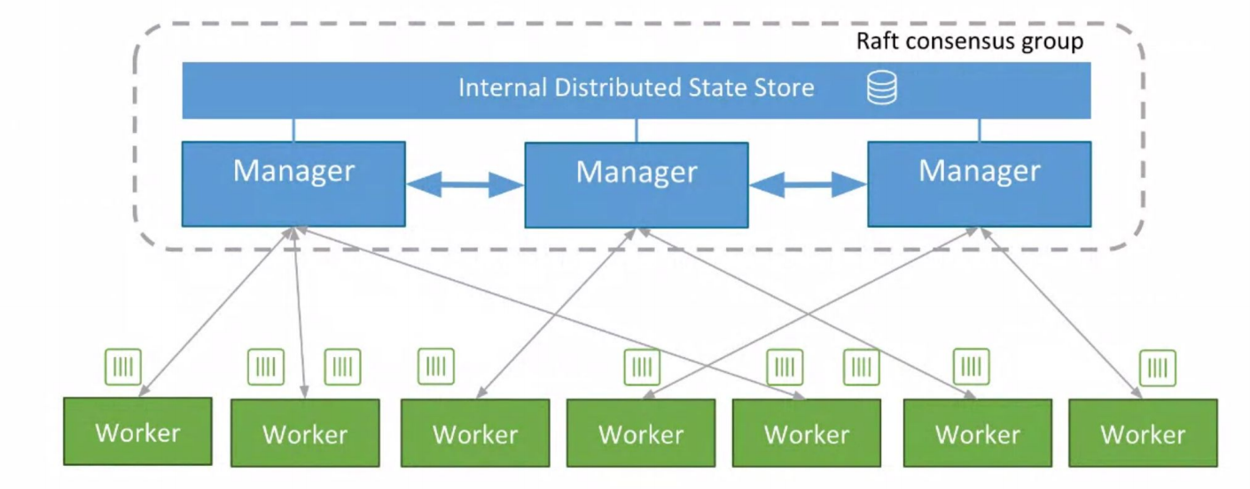
Container Orchestration Wars
Swarm Architecture （Build-in Orchestration）
http://www.slideshare.net/PhilippGarbe1/dockercon-2016-seattle-recap?qid=30f21fe6-66ea-4a1d-9234-7da4a9482048&v=&b=&from_search=2

Slide 29
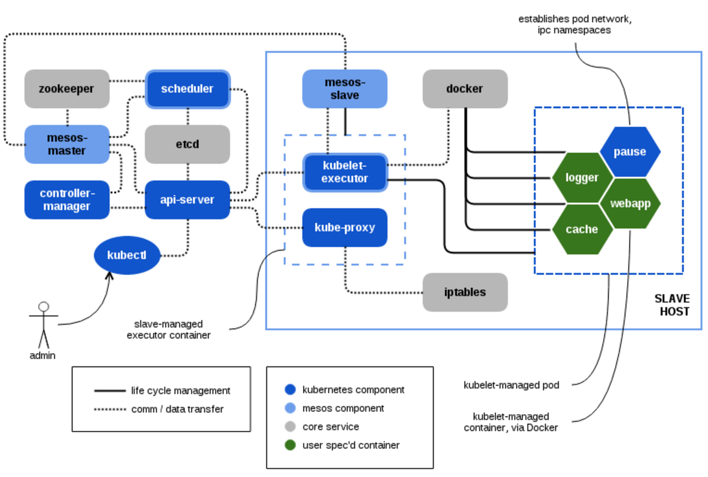
Container Orchestration Wars
Kubernetes Architecture
https://mesosphere.com/blog/2015/09/25/kubernetes-and-the-dcos/

Slide 30
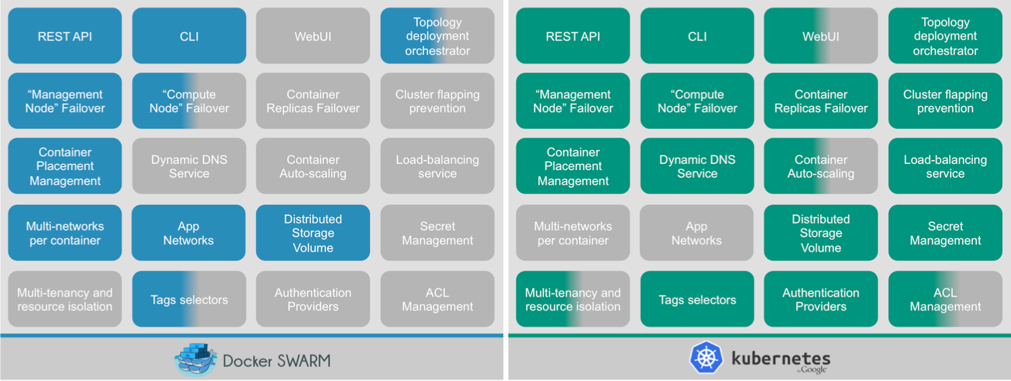
Container Orchestration Wars
Swarm vs Kubernetes
Édouard Devouge, Arnaud Mazin10/03/2016
http://blog.octo.com/docker-en-production-la-bataille-sanglante-des-orchestrateurs-de-conteneurs/

Slide 31
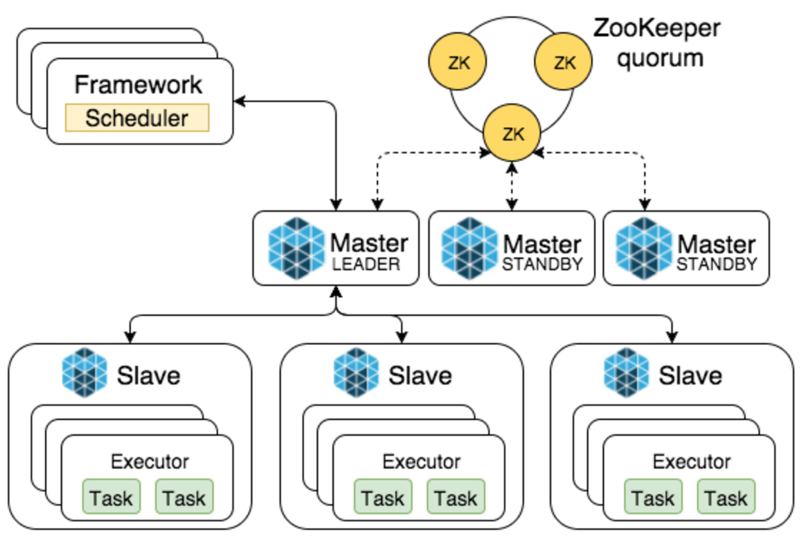
Container Orchestration Wars
Mesos Architecture
http://datastrophic.io/data-processing-platforms-architectures-with-spark-mesos-akka-cassandra-and-kafka/

Slide 32
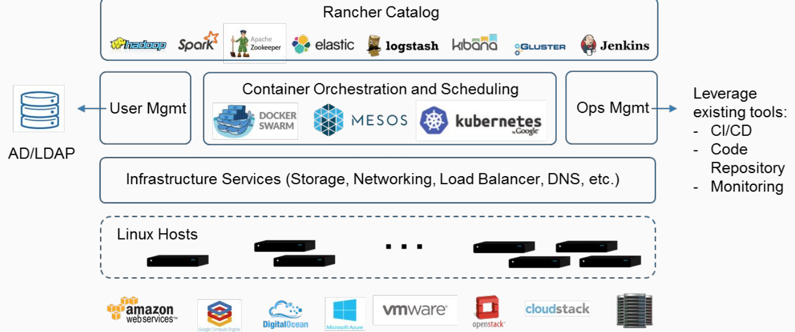
Container Orchestration Wars
Rancher Architecture
http://www.slideshare.net/NickThomas56/automate-cicd-with-rancher-66996266?qid=227a6df3-6d1d-4046-89a1-1b04632cd127&v=&b=&from_search=4

Slide 33
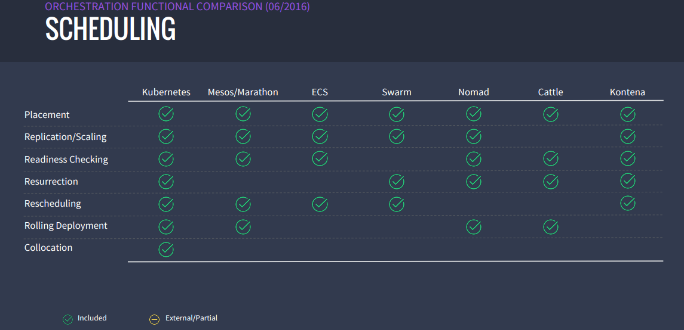
Container Orchestration Wars
http://www.slideshare.net/KarlIsenberg/container-orchestration-wars

Slide 34
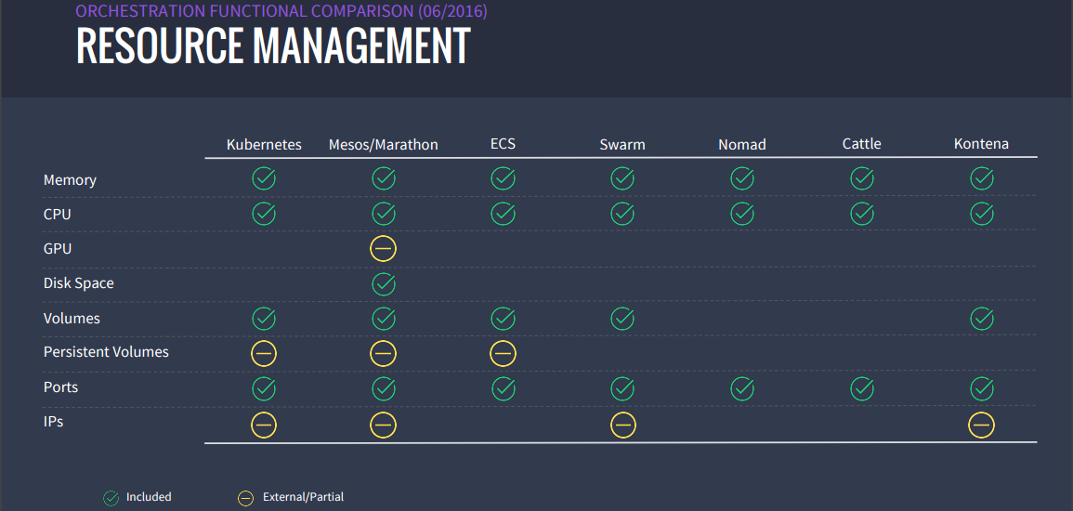
Container Orchestration Wars
http://www.slideshare.net/KarlIsenberg/container-orchestration-wars

Slide 35
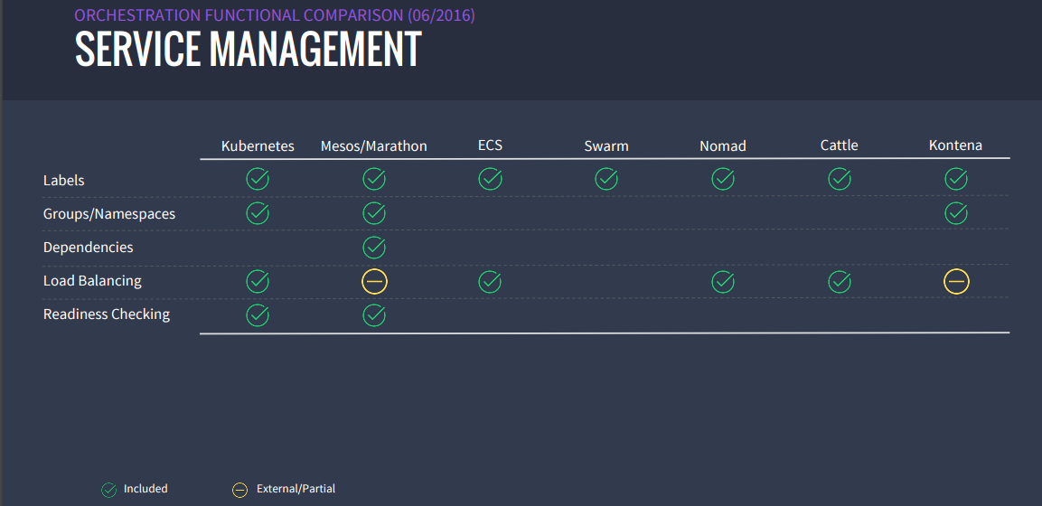
Container Orchestration Wars
http://www.slideshare.net/KarlIsenberg/container-orchestration-wars

Slide 36
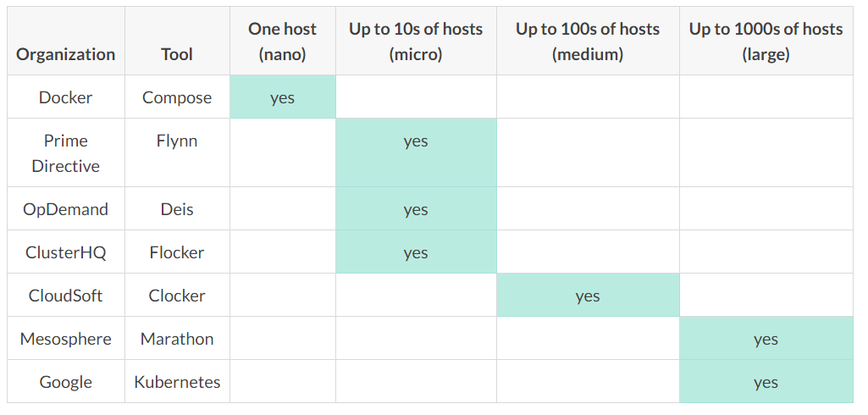
Container Orchestration Wars
Size comparison of container orchestrators and managers
October 18, 2015
https://getcarina.com/docs/best-practices/container-technologies-orchestration-clusters/

Slide 38
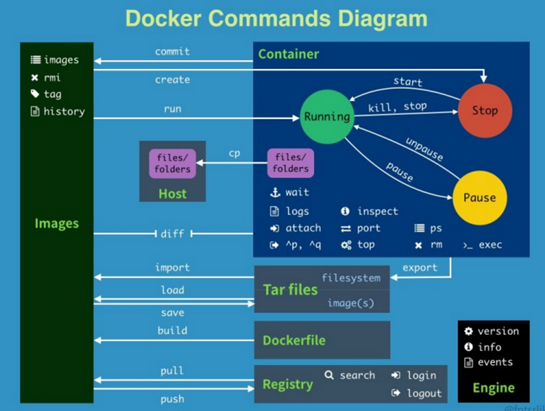
Refer
http://www.slideshare.net/zx1986/docker-66986880?qid=1d1461b5-ac95-4303-b06f-10afb72ae4b3&v=&b=&from_search=12

